Slide 1

State of the OAI and OAS
Notes:
A product of about a year and a half work.
Released end of July 2017

Slide 2

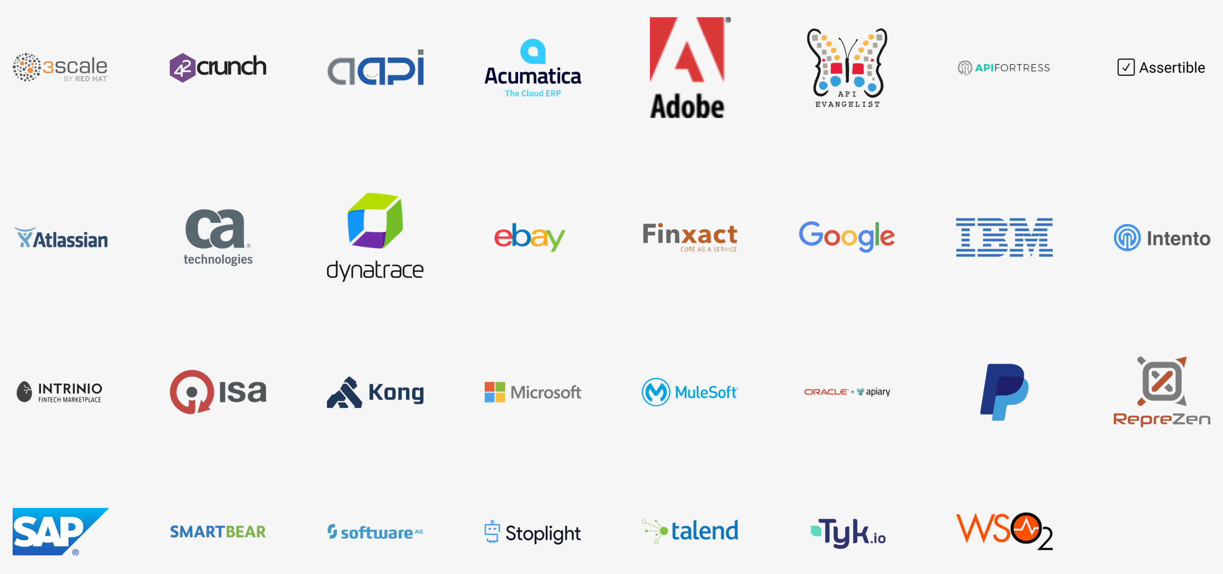
The OpenAPI Initiative
Provide an open source, technical community, within which industry participants may easily contribute to building a vendor-neutral, portable and open specification for providing technical metadata for REST APIs
The OAI is a collaborative project under the guidance of The Linux Foundation. LF Projects use open source governance best practices, including license and contribution agreement choices, in keeping with the ideals of Linux.

Slide 3
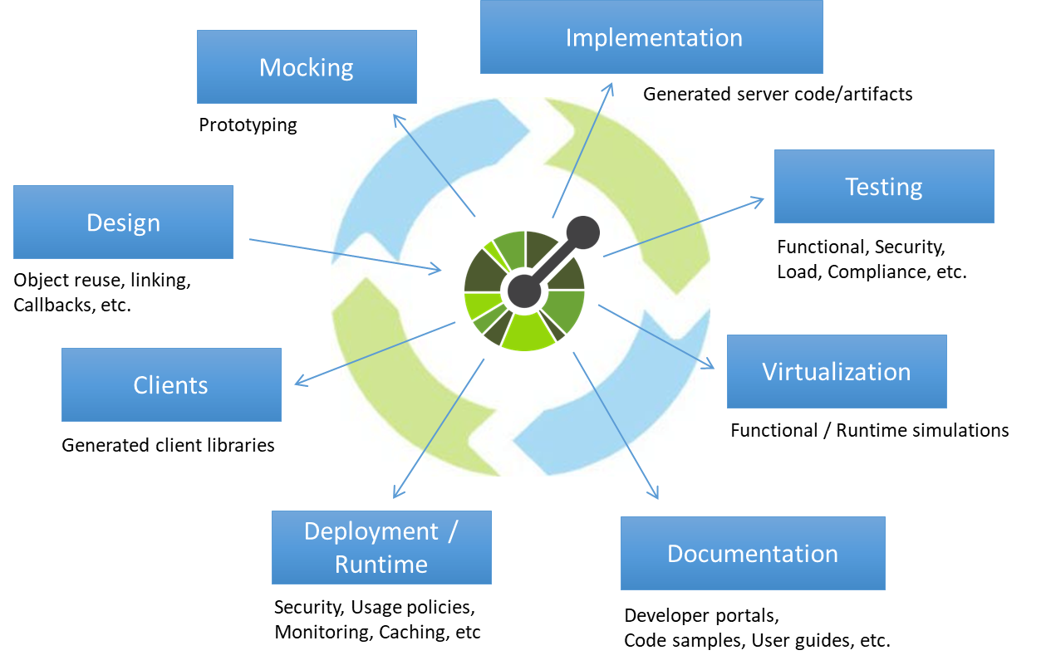
OAS Opens Up A World Of Possibilities

Slide 4


Evolution of the OAS
2010: Wordnik created the Swagger tools
2011: The Swagger tools were open sourced
2011-2015: Massive adoption of the Swagger Specification and tooling
2015: Swagger Spec and core tooling acquired by SmartBear
2015: The OpenAPI Initiative was created to standardize REST design. Swagger Spec was renamed as the OpenAPI Specification.
2017: The OpenAPI Specification 3.0.0 is released

Slide 5

Core differences between OAS2 and OAS3
Structural improvements
Servers support
Parameter changes
Enhanced examples
Changes to resposes
Links and Callbacks
Extended JSON Schema support
Extended Security definitions

Slide 6
Structural Improvements
OpenAPI 2.0
OpenAPI 3.0
info
info
host
security
servers
security
basePath
securityDefinitions
schemes
produces
consumes
paths
paths
tags
externalDocs
tags
externalDocs
definitions
parameters
components
responses
Notes:
Following the color scheme, that's what was consolidated
Expand on components:
Nothing in here does anything unless it is referenced
It is referenced by $ref
Recommend using dot for namespacing
Limited character-set for compat with URLs and widest platform support

Slide 7
Introducing Servers
servers:
- url: https://{user}.big-server.com:{port}/{path}
description: The production API server
variables:
user:
default: demo
port:
enum:
- 8443
- 443
default: 8443
path:
default: v2
Replaces schemes, host, basePath
Allows definition of multiple servers
Variable substitution support
Defined at top, path or operation level
Notes:
Templating basepath

Slide 8
Parameters Overview
Path
Query
Header
Form Data
Body
Path
Query
Header
Cookie
Request Body
2.0
3.0
Notes:
Specify different Media Types
Supports reusability
Provide examples
Replaces formData parameters
Improved file upload handling
Supports multiple file uploads
Eliminated File Type
Examples per media type
Supports schema for all parameter types
Content for more complex data structures
Support for URI Template (RFC 6570), dropped collectionFormat
Support for Matrix parameters
5. Headers are case insensitive

Slide 9
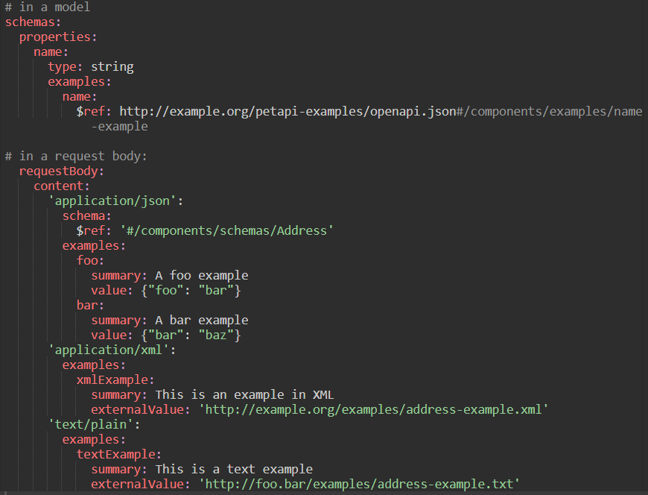
Enhanced Examples
Examples can live in Parameters, Request Bodies, Responses and Schemas (*)
Examples can be reused
Additional Metadata
Name
Description
Can reference an external example
Notes:
Content Negotiation
Schema offers examples as well

Slide 10
Responses
Wildcard response codes
Response headers can be complex types too
Content for payload
Introducing: Links
Notes:
Content Negotiation
Schema offers examples as well

Slide 11
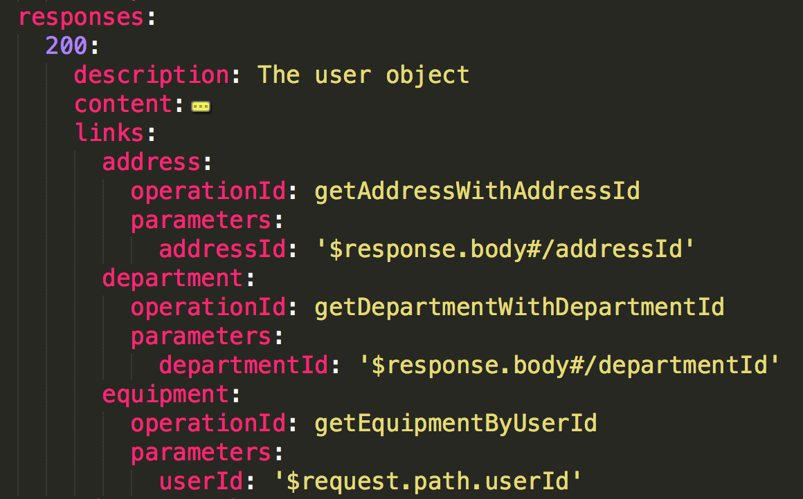
Links
Statically link responses to related operations
Use an expression language to pass parameters
Ability to link to operations internally or externally

Slide 12
Callbacks
myWebhook:
'$request.body#/url':
post:
requestBody:
description: Callback payload
content:
'application/json’:
schema:
$ref: '#/components/schemas/SomePayload'
responses:
200:
description: webhook successfully processed an no retries will be performed
Notes:
Expression language to describe the return URLs – webhooks, asynchronous calls.

Slide 13
JSON Schema
Updated support to latest Wright Draft 00 (Draft 05)
Added support for oneOf, anyOf, not
nullable, deprecated, writeOnly
Clarified JSON References
Clarified other restrictions
Notes:
Format Registry

Slide 14
Security Definitions
OAuth2 flow names finally make sense
Multiple flow support
Introduced support for OpenID Connect
Replaced `basic` with `http` and…
Added `scheme` and `bearerFormat`

Slide 15
OAS 3.1? (#1466)
Reusable groups
Supporting Message Based APIs
Optional and Multi-segment Paths
Disambiguating based on query
Overlays
Security Improvements
Operation Versioning
Alternative Schemas
Draft Features

Slide 16
Draft Features
The ability to add new features to the spec for testing purposes by the community and tool vendors to adapt, before finalizing as part of the specification.
Alternative Schemas
Support for modeling languages other than JSON Schema to describe models (such as XSD, Protobuf…)

Slide 17
Overlays
Allowing for manipulation of existing API definitions, by adding or changing content to them. For example, description translations.
Security Improvements
Support for encryption descriptions, better support for existing flows.

Slide 18
Reusable Groups
The ability to define reusable groups of components such as parameters or responses, and reference those as a whole.
Message Based APIs
Adding support for event-driven APIs.

Slide 19
Optional/Multi-Segment Paths
Today path parameters are mandatory. The goal is to allow a zero/one/many instance(s) of a path parameter.
Query Param Disambiguation
The ability to separate operations based on query parameters and their values, and not just based on the path alone.

Slide 20

Get Involved! Follow @OpenApiSpec
Blog series on spec changes:
bit.ly/openapi3changes
OAI Website:
openapis.org
On GitHub:
https://github.com/OAI
Notes:
Thanks to Darrel Miller for his initial slides and to Marsh Gardiner for some spit and polish! Add your name here if you've moved the ball forward again, just be sure to share this back with OAI so others can benefit.

